Slide 1
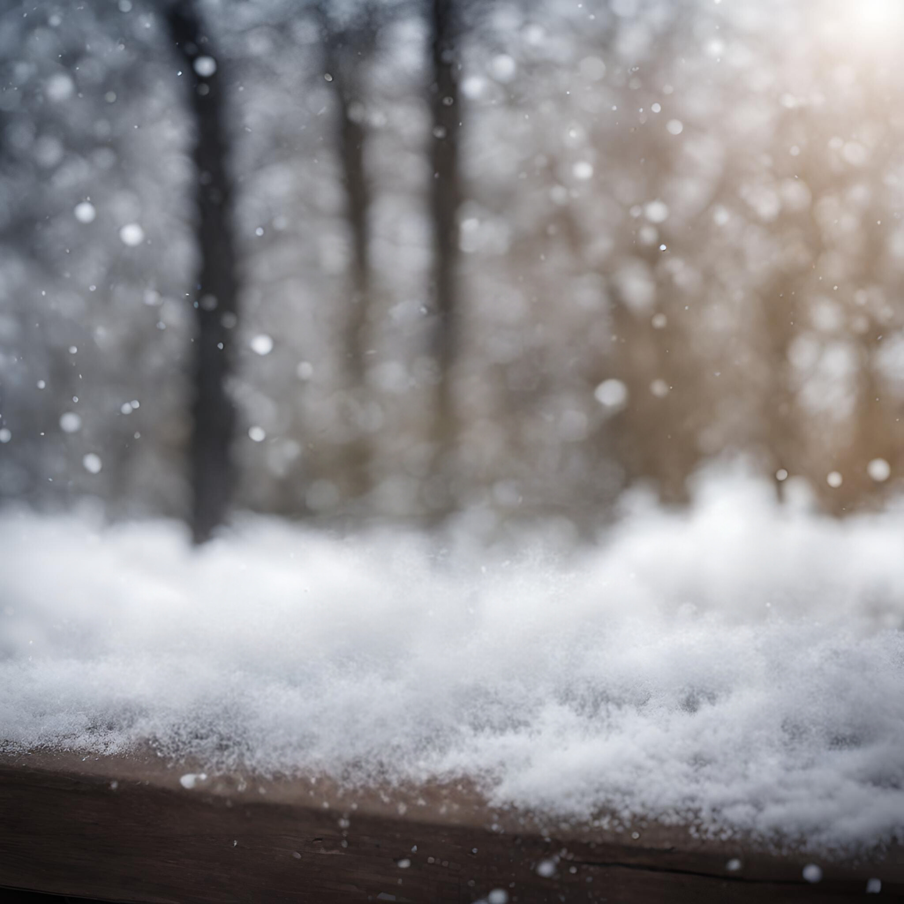
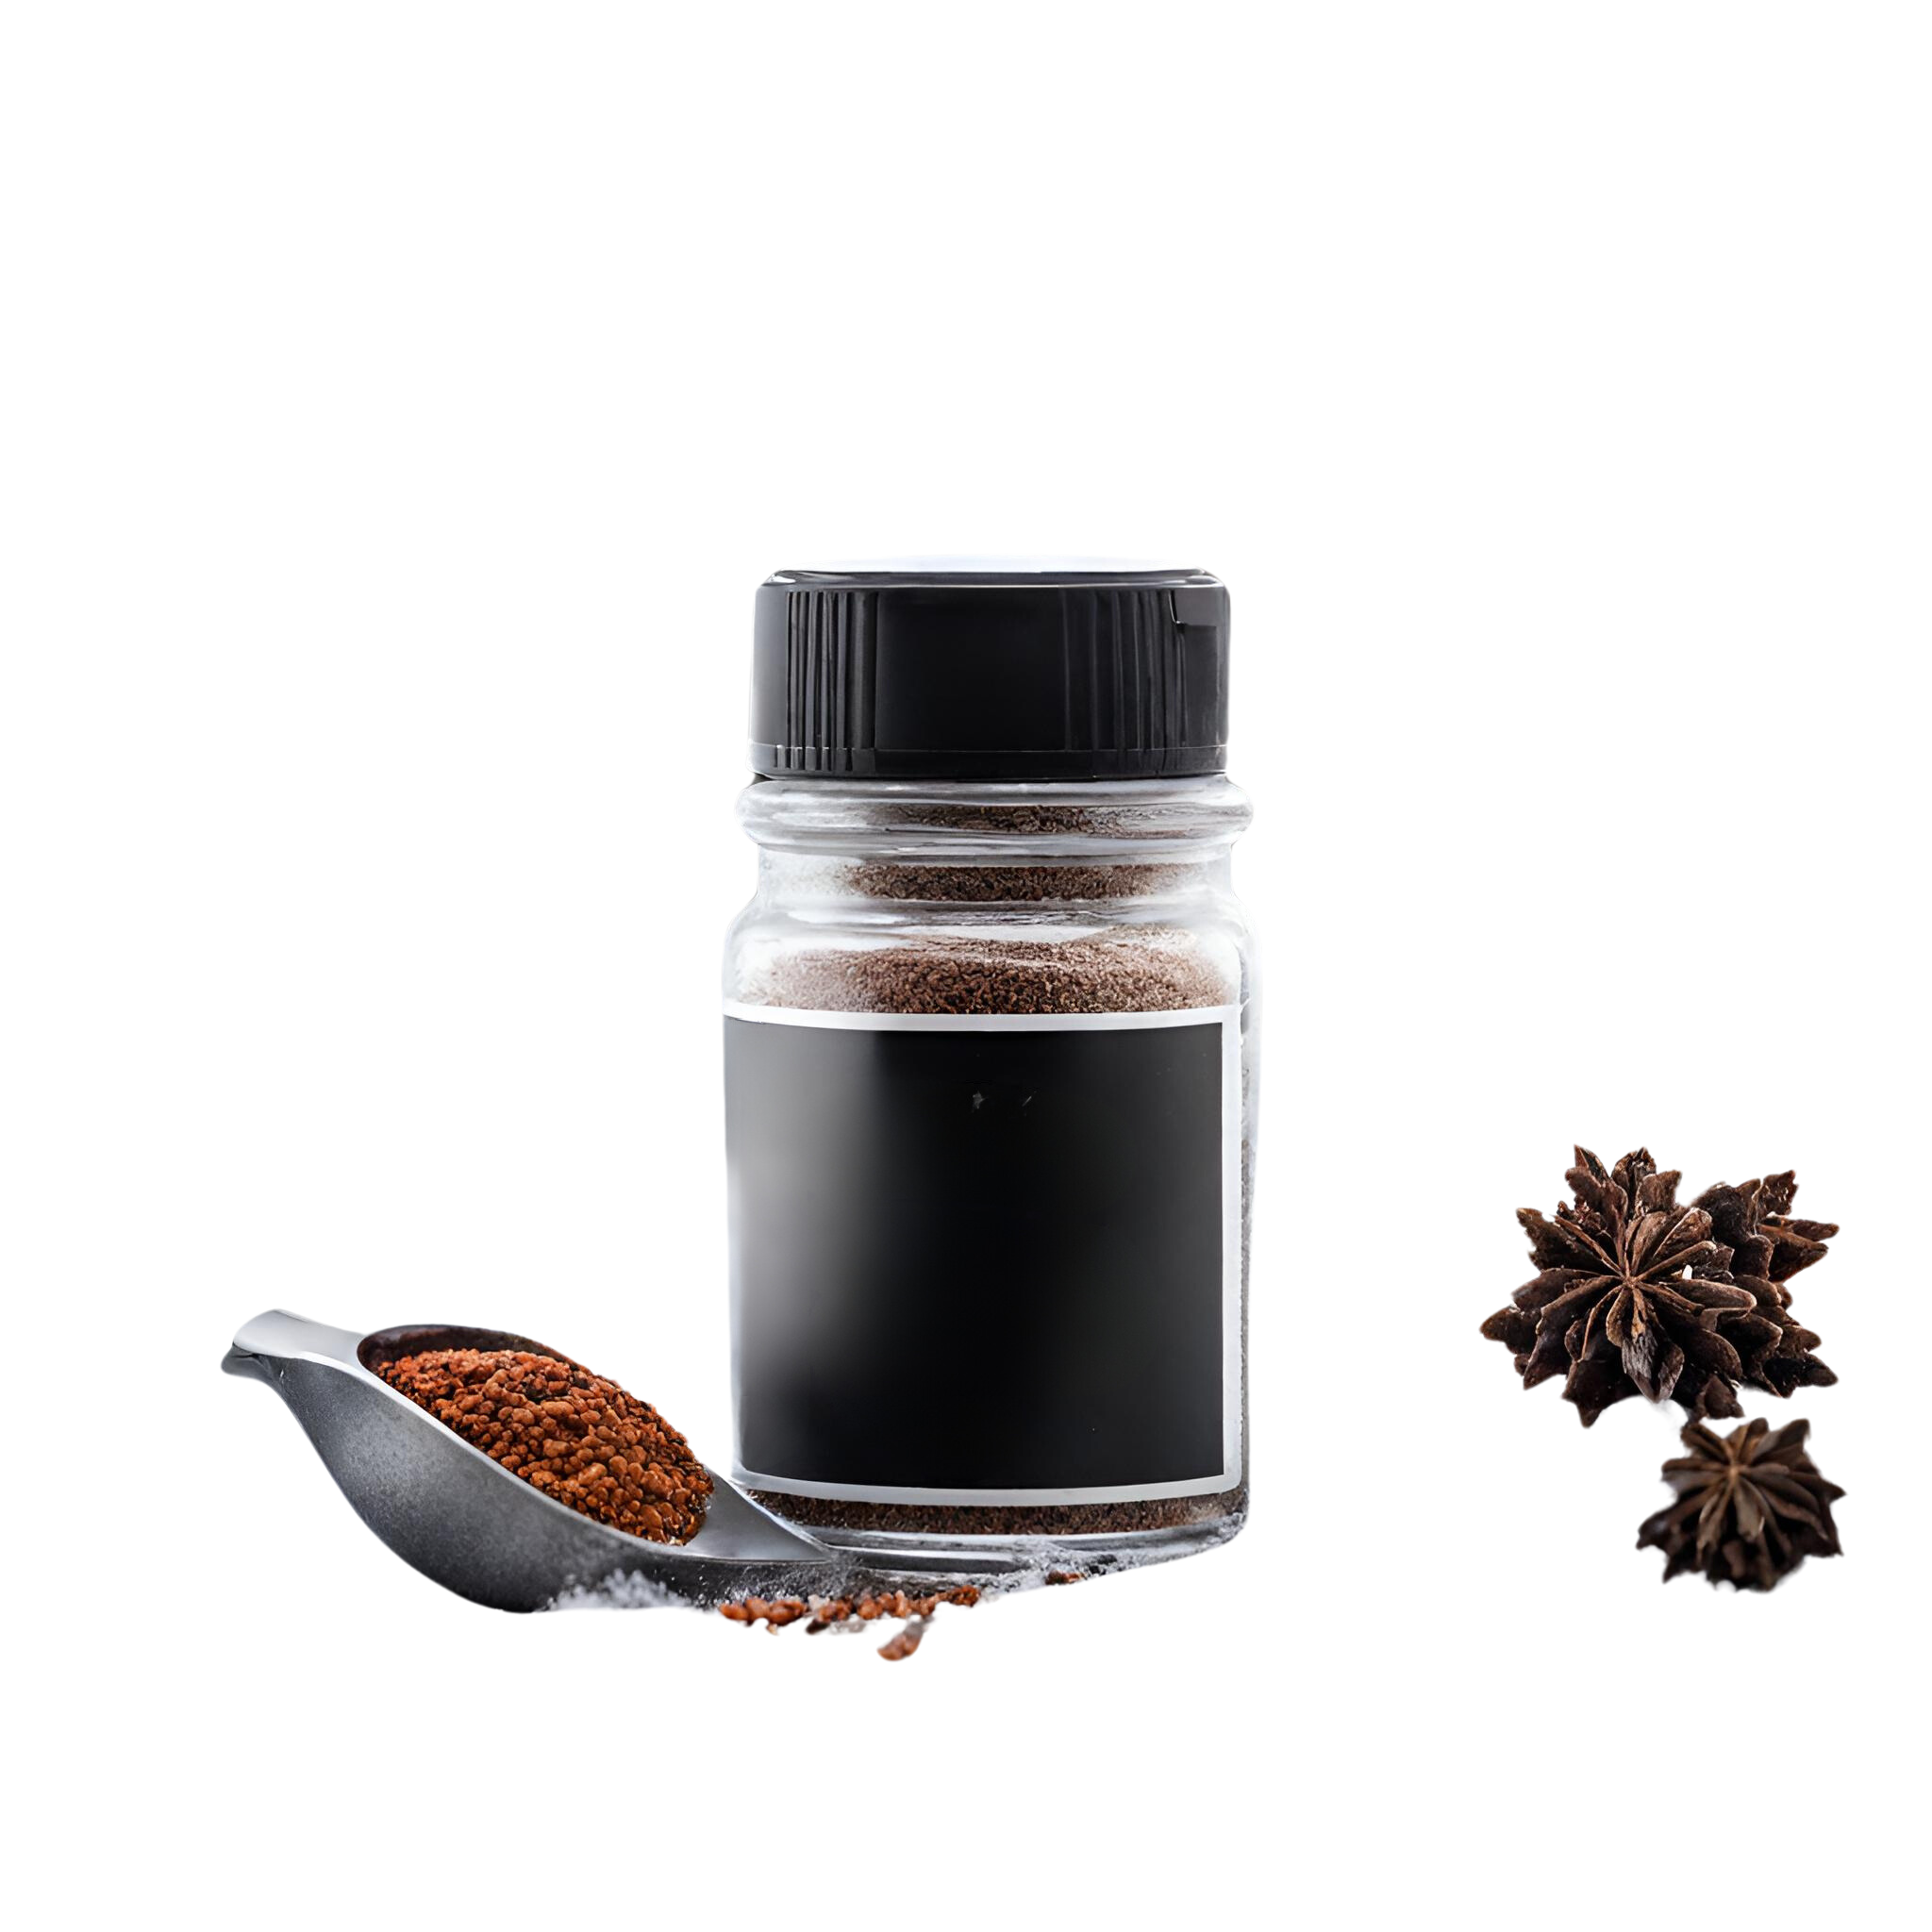
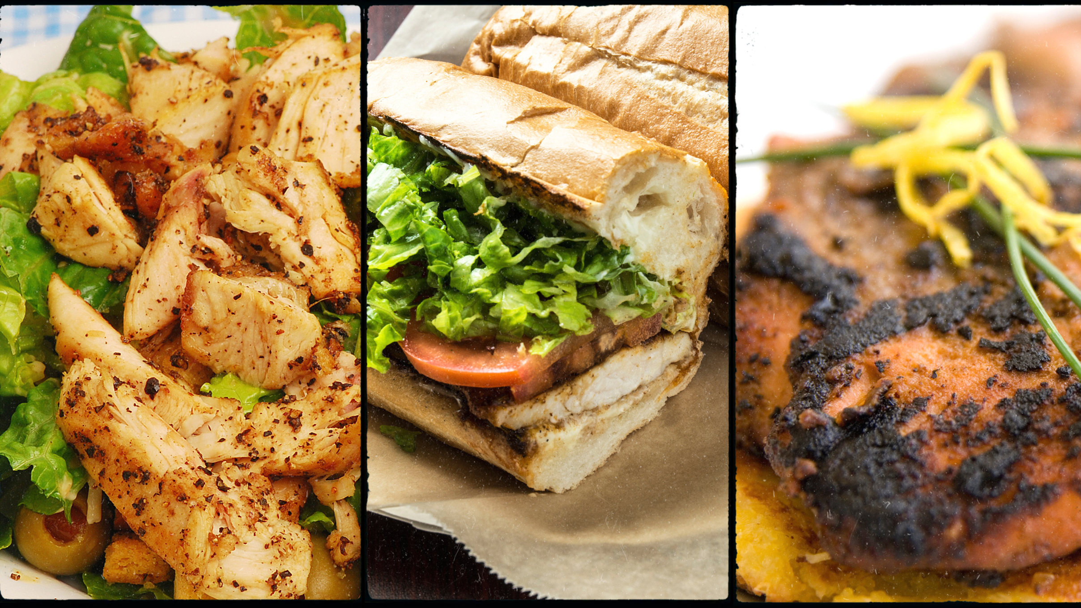

PRODUCTS
OUR STORY
LEGAL STUFF
SHOPPING CART
A BLIZZARD OF FLAVOR IN EVERY BITE!
Amy Snowhill- School Project
Snowman’s
snowmansseasonings.com
BLACKENING SPICE

Slide 2
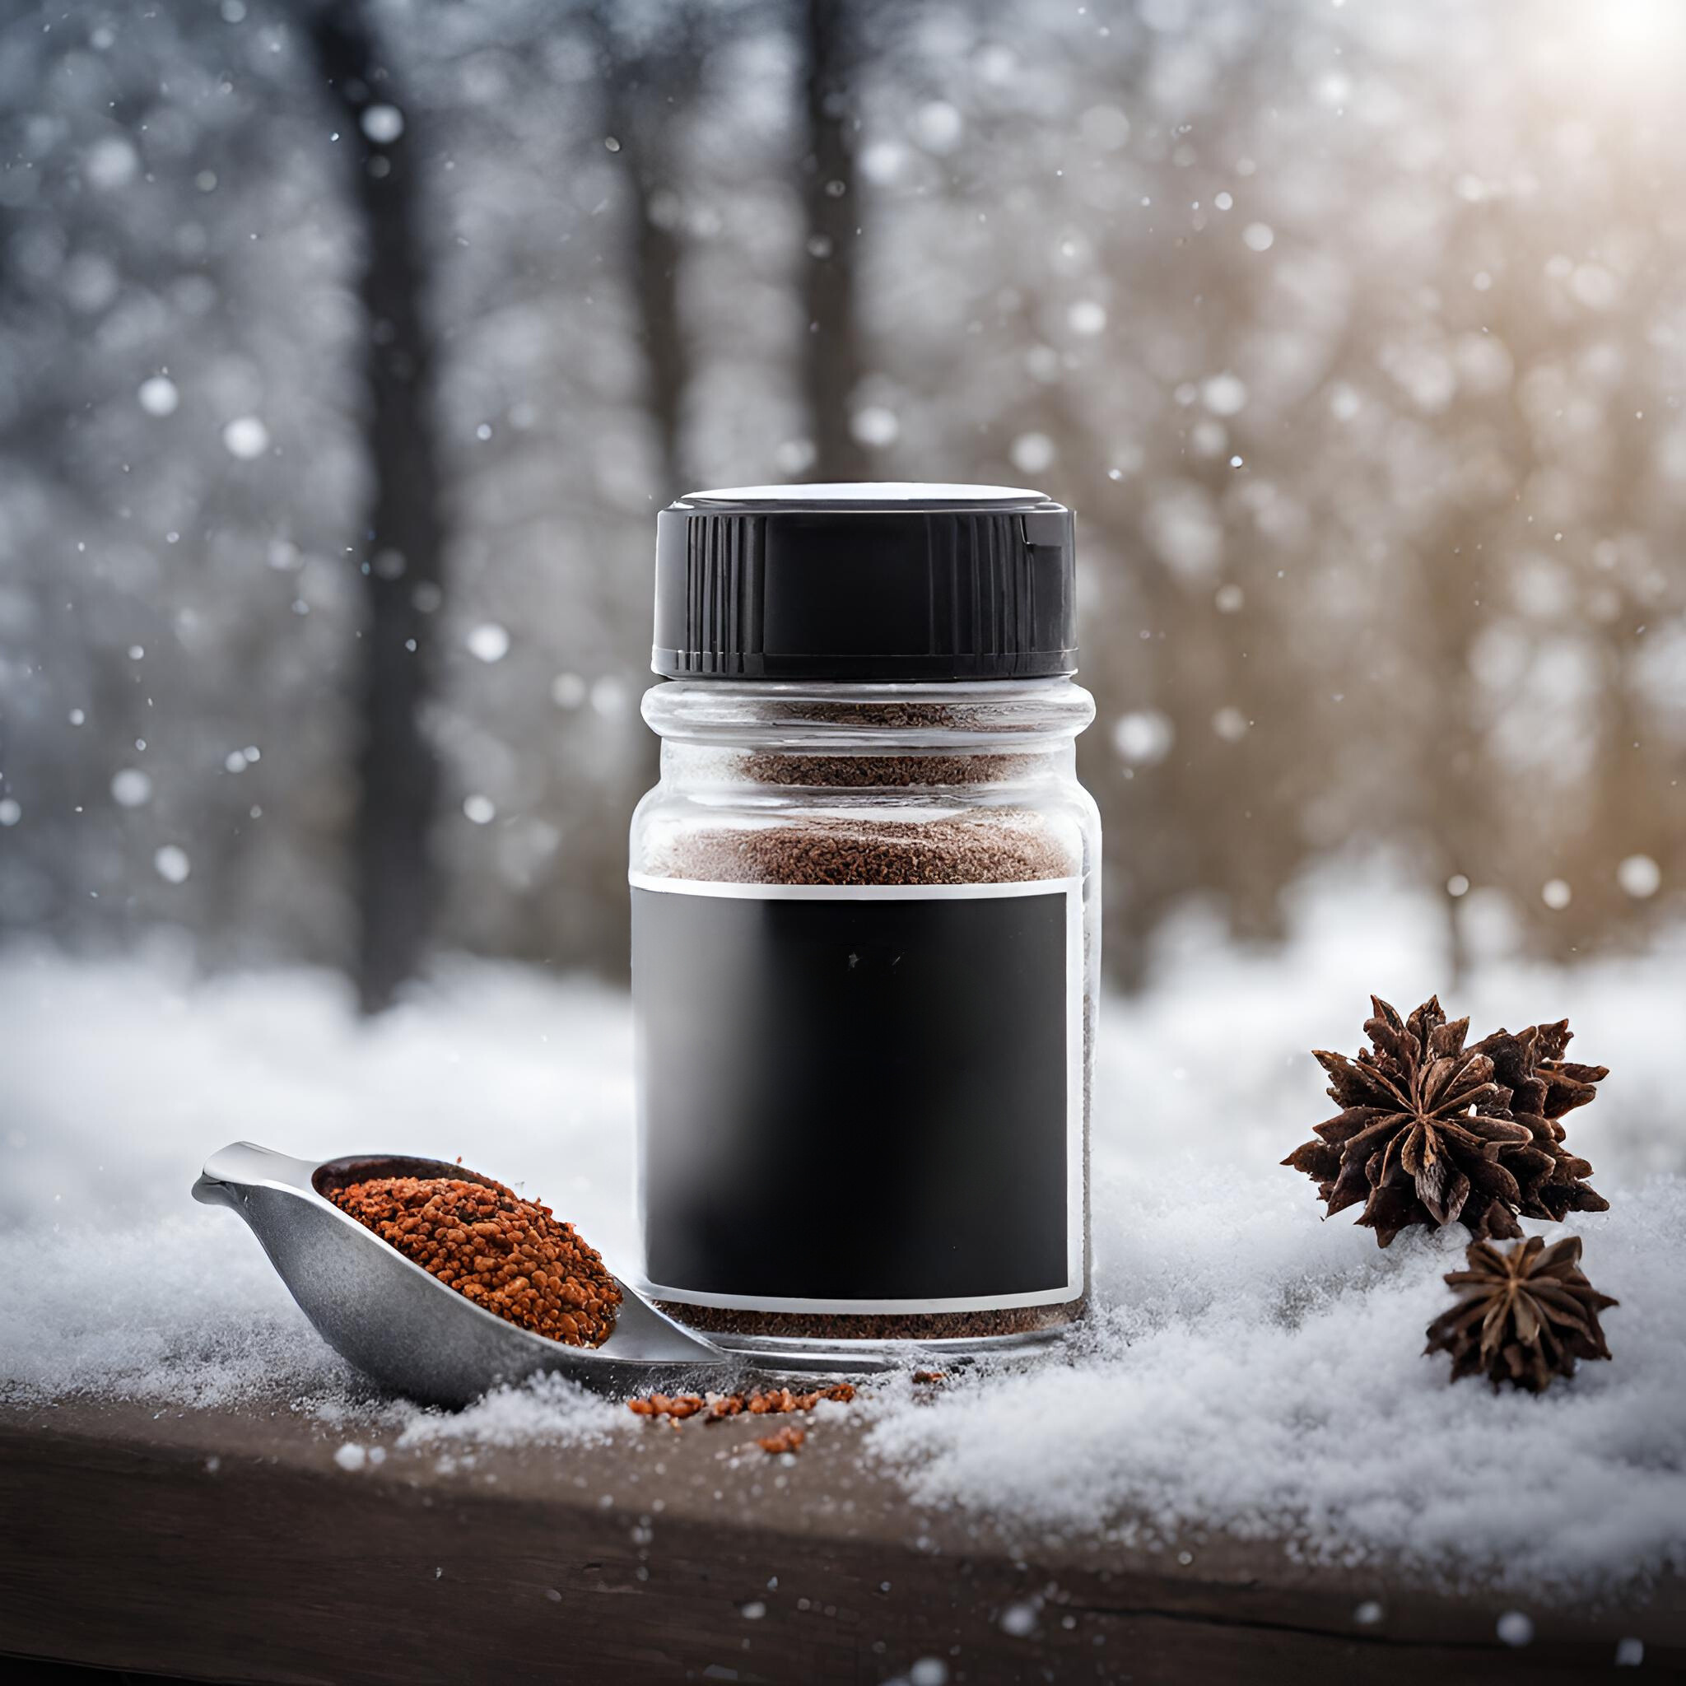





5 Delicious Flavors:
ORIGINAL BLACKENING SPICE
SEASON SALT
Amy Snowhill- School Project
CURRY SPICE
SPICY SUGAR
Snowman’s
JERK SEASONING
ORDER NOW
BLACKENING SPICE
HOME

Slide 3
Order Form
Contact Details
Last Name
First Name
FLAVOR | QUANTITY | SUBTOTAL
BLACKENING SPICE 10 OZ
BLACKENING SPICE 20 OZ
JERK SPICE 10 OZ
JERK SPICE 20 OZ
CURRY SPICE 10 OZ
CURRY SPICE 20 OZ
SPICY SUGAR 10 OZ
SPICY SUGAR 20 OZ
SEASON SALT 10 OZ
SEASON SALT 20 OZ
TAX |  | TBD
SHIPPING |  | FREE
TOTAL |  | $0.00
Phone Number
Email Address
Amy Snowhill- School Project
Payment Details
Credit/Debit Card #
Expiration Date CVV#
Shipping Information
Street
Address
Apt # City
State Country
Zip Code
HOME

Slide 4
Snowman’s Seasonings
OUR STORY
In his cozy, spice-filled kitchen, a man, with a keen palate and a passion for grilling, created a unique spice blend during a summer barbecue. Its distinct flavor and instant popularity among friends and family inspired him to share his culinary discovery with the world. This singular creation laid the groundwork for a small, ambitious company dedicated to bringing his signature home-grilled perfection to food enthusiasts everywhere.
Amy Snowhill- School Project
ORDER NOW
HOME

Slide 5
Terms and Conditions for Snowman's Seasonings: The Online Seasoning Boutique
1. Introduction
Purpose: These Terms and Conditions are intended to guide the use of Snowman's Seasonings, a unique online destination for premium seasoning blends and culinary spices.
Acceptance of Terms: By accessing and engaging with Snowman's Seasonings, you agree to adhere to these terms.
2. User Accounts
Account Creation: Users must provide truthful and complete information during the account creation process.
Account Responsibilities: Users are accountable for safeguarding their account information and password confidentiality.
3. Privacy Policy
Data Collection: We collect essential personal information for processing orders, customer relations, and optional marketing outreach.
Data Usage: Personal information is utilized for fulfilling orders, managing user accounts, and providing updates and promotional content to those who opt in.
4. Intellectual Property
Content Ownership: All website content, including graphics, text, logos, and proprietary seasoning recipes, belongs to Snowman's Seasonings or is used under authorization.
Use of Content: This content is for personal use only and cannot be reproduced, copied, or sold without explicit permission from Snowman's Seasonings.
5. Product Information
Descriptions and Pricing: We endeavor to be accurate in our product descriptions and pricing, but discrepancies may occasionally occur.
Availability: Our products are available while supplies last, and we reserve the right to discontinue any item.
6. Purchase and Payment
Payment Methods: We accept a variety of payment methods, as detailed on our website.
Payment Security: We use SSL technology to ensure the secure processing of payment information.
7. Shipping and Delivery
Shipping Policies: Domestic shipping options are available with estimated delivery times provided at checkout.
International Shipping: At this time, we do not offer shipping outside our domestic region.
8. Cancellations, Returns, and Refunds
Cancellation Policy: Orders can be canceled within 24 hours of placement without penalty.
Return Policy: Returns are accepted within 30 days of receipt for unopened products in their original condition.
Refund Policy: Refunds are issued to the original payment method within 14 days of return receipt.
9. User Conduct
Prohibited Activities: The website must not be used for illegal purposes or in any way that may damage, disable, or impair the service.
Consequences of Violation: Breaching these terms can lead to account termination and possible legal action.
10. Limitation of Liability
Disclaimers: Snowman's Seasonings is not liable for any indirect or consequential damages that arise from using our services.
Indemnification: Users agree to indemnify Snowman's Seasonings against all claims, damages, and expenses arising from their breach of these terms.
11. Dispute Resolution
Governing Law: These terms are governed by the laws of [Your Jurisdiction].
Dispute Resolution Process: Disputes are resolved through binding arbitration, rather than in court.
12. Changes to Terms and Conditions
Amendments: These terms may be updated periodically. Continued use of Snowman's Seasonings after such changes constitutes agreement to the new terms.
13. Contact Information
Contact Details: For inquiries or assistance, please contact us at [support@snowmansseasonings.com].
14. Miscellaneous
Severability: If any part of these terms is found to be unenforceable, the remainder will continue in effect.
Waiver: Not enforcing any right or provision here does not constitute a waiver of such rights.
Amy Snowhill- School Project
HOME

